Slide 1
County of Otsego IDA Broadband Feasibility Study
November 25, 2014

Slide 2
Opportunity
Deliver broadband access to unserved areas of the County
Dramatic underinvestment over decades by incumbent carriers in the County
Dial up Internet access in many rural areas
Limited DSL / cable modem / fixed wireless in parts of rural areas at speeds much less than 10 MB down and 1 MB up
Satellite providers have costly monthly data packages and bandwidth capacity is limited
Federal and state grant and loan programs available

Slide 3
Structure
Public Private Partnership
Potential Partners
Otsego County
Tower sites, bonding
Otsego Electric Cooperative
Access to poles, construction and maintenance operations
Telecommunications Provider
Operational systems and regulatory experience
County of Otsego IDA
Grant writing / marketing expertise, PILOT/Property Tax Relief, Financing/Funding partnership and overall Funding Applications/Project coordination

Slide 4
Structure
Recommend engaging accounting and legal advice to evaluate Cooperative, Non Profit Corporation and other corporate / partnership / joint venture options

Slide 5
Technology Solution
Hybrid wireless and fiber network
Initial network provides high speed broadband access to 19,800 (84%) unserved locations
Hybrid network minimum bandwidth is 10 MB down / 1 MB up
Ongoing network build out to reach remaining unserved locations (16%)
Can include larger end user antenna, range extenders, micro cells, new tower sites and additional Fiber To The Premises (FTTx) construction
May be financed by a combination of additional grants and loans or out of retained earnings

Slide 6
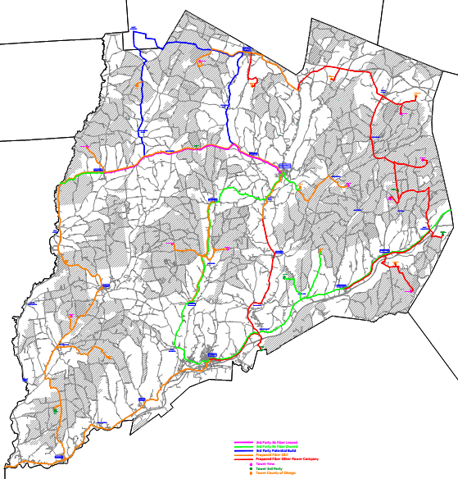
Technology Solution
Ring 3
Ring 2
Ring 1

Slide 7
Technology Solution
Hybrid wireless and fiber network
25 wireless towers connected by fiber backbone
Wireless fixed broadband access in remote areas of County
Serves 10,800 locations
Minimum speed 10 MB down / 1 MB up

Slide 8
Technology Solution
Hybrid wireless and fiber network
FTTx solution for community centers, home based businesses, Main Street businesses and residents along the fiber routes
Fiber backbone includes 3 rings
210 miles of new fiber
120 miles of leased existing fiber
Serves 9,000 locations / 13 community centers
Minimum 25 MB down / 25 up, Gigabit speeds possible

Slide 9
Financials
Estimated project cost - $30.3 million
50% loans including working capital
50% grants
Profitable operations, positive cash flow throughout the six year projection period
Financial ratio benchmarks met

Slide 10
Project Summary
Strong customer demand for high speed broadband services
Drives positive financial projections
Potential partners bring strong experience and assets to the Public Private Partnership
Loan and grants funds are available
Very challenging terrain for both FTTx and fixed wireless services
Several strategies available to extend service after initial build out plan
Public Private Partnership will develop marketing plan

